Slide 1
what 3 words
And why the TATC may be want to incorporate this software
into how we share directions to our events
Andy Grayson
7-12-23

Slide 2
Why Use “what 3 words”
Have you ever followed an event leader’s written directions and either not been confident you were in the right place, or worse yet, get there and not find the group?
Are some of the locations we meet a little obtuse? The Admin Building? The CCC Kitchen? Williams Branch? The Mariner’s Museum parking lot (it’s kind of large and parts of it are out of site from other parts), etc.
When driving to an event, have you ever wished you could just load the “address” into Google Maps and get told where to go and how to get there?
The app “what 3 words”, paired with Google Maps, offers an easy smartphone based solution that only requires an internet at the start, but not at the final destination

Slide 3
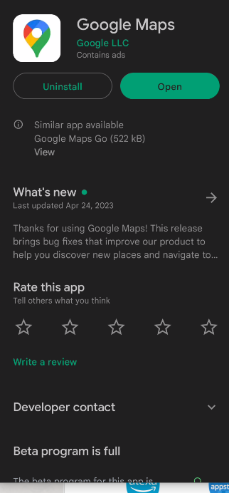
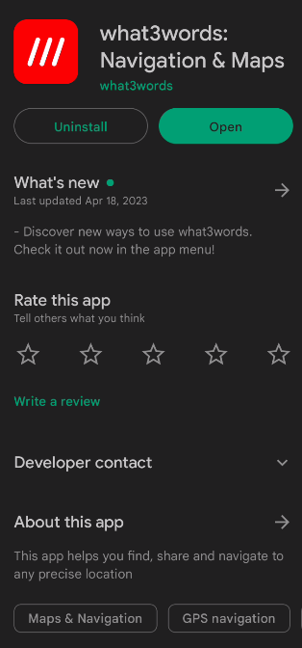
Step 1 – Install and Setup Both Apps
If you have not already downloaded and installed both Google Maps (or similar) and what3words onto your phone, please do that now!
Open each app and complete the registration /setup steps if needed.
Most of this presentation is hands-on training on how the app works
While you do that, let take a look at a TED Talk video about what inspired what 3 words

Slide 4
TED Talk Video on what 3 words

Slide 5
Potential 1st World uses -
Getting to TATC event starting points (CCC Kitchen, Cow Pasture, etc.)
Providing location info to Emergency Services personnel (police, fire, ambulance, tow truck) if on the road or in the wilderness
Helping folks locate you at a large event (concert, ballgame, etc.)
Marking where you parked your car at the mall, concert, ballgame, etc.
Marking locations during walk-throughs (this is a possibility, but is not yet in practice)

Slide 6
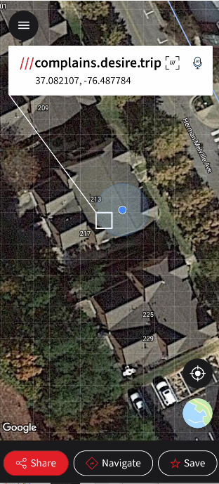
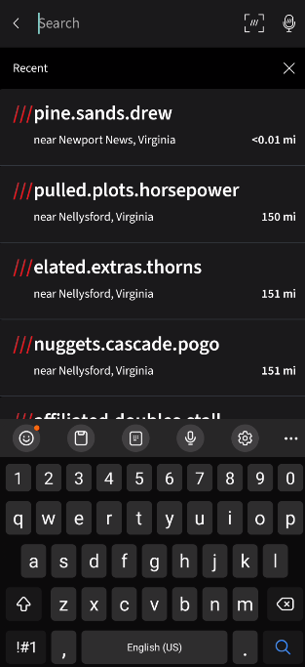
Step 2 – what3words Basics
Once you select the address bar, you will see this screen. You can use your phone’s camera to “read” a W3W address by pressing the /// icon.
Type address here, either in W3W format or standard address format
When you open “what 3 words”, you should see the screen on the left.
Once you have a location input, you can use the 3 buttons at the bottom to Share, Navigate or Save the address.
The “///” before the words does not need to be typed in, but it is the general format of how w3w addresses are shown.
Tapping this icon centers the map on your current location (if gps is turned on)
Tapping the globe toggles between “satellite” view and “street” view

Slide 7
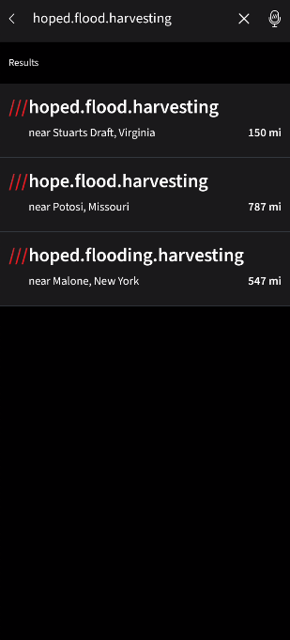
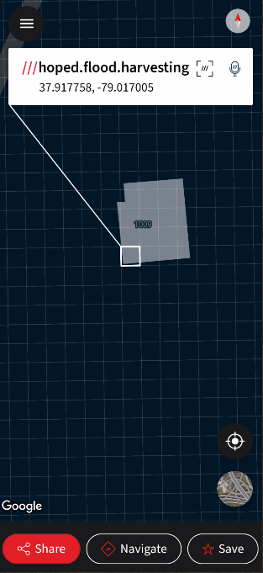
Step 3 – Lets Walk Through An Example….
Type ///hoped.flood.harvesting into the what3words app
This should provide an option near Stuarts Draft, select that one.
Using the standard pinch-zoom-method, zoom out. Where is this?

Slide 8
Step 3a – An Example….
Type ///hoped.flood.harvesting into the what3words app
This should provide an option near Stuarts Draft, select that one.
Using the standard pinch-zoom-method, zoom out. Where is this?
THE CCC KITCHEN!!

Slide 9
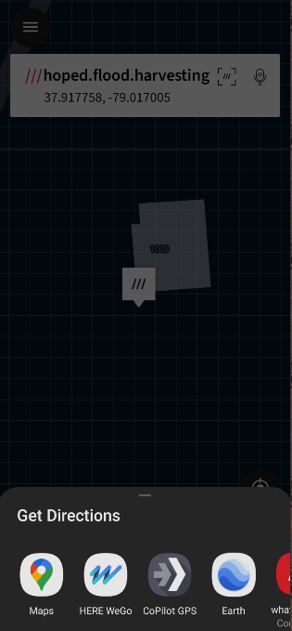
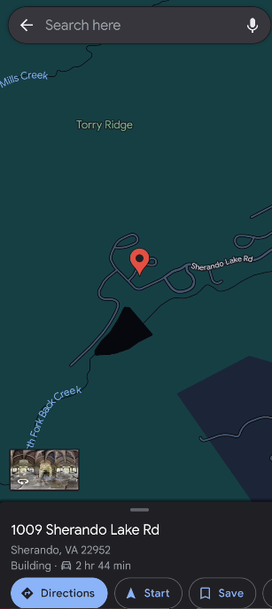
Step 4 – Now, on to Mapping!
Now select the “Navigate” from the bottom-center
Then select “Maps”, you may need to drag the “Get Directions” row of icons to the left or right to see Google Maps.
Maps should open and display the 1009 Sherando Lake Rd address

Slide 10
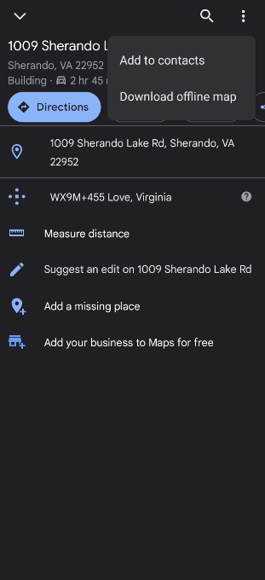
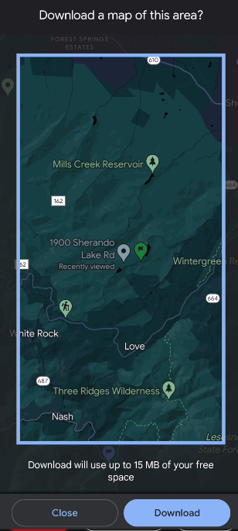
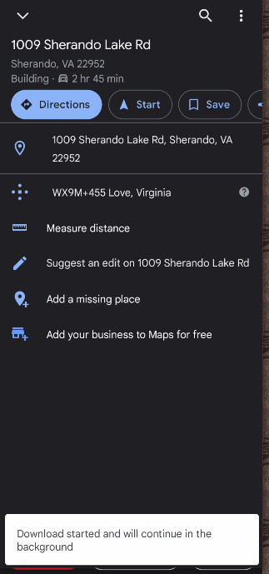
Step 5 – A CRITICAL, but EASY TO MISS, STEP!
If you will not have internet at your final destination, you should download the map data to your phone!!!
Select the address from the bottom of the screen (see previous slide)
Select the 3 dots in the upper right-hand corner, then select “Download offline map”.
On the next screen, select “Download”,
Then the message in the white box should be visible (briefly).

Slide 11
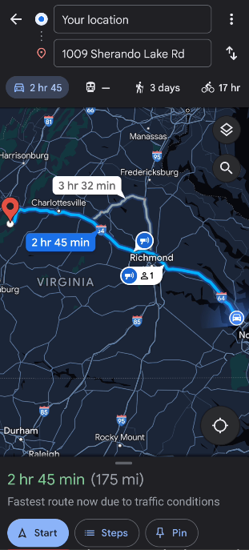
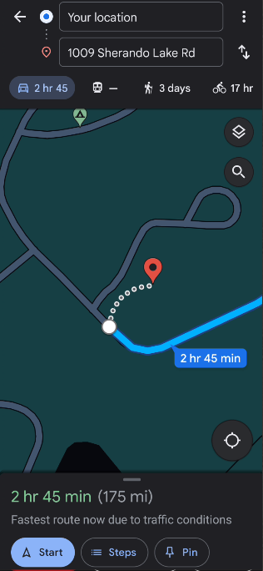
Step 6 – Ready to Roll!!
At this point follow standard Google Maps usage.
If you zoom in on the destination, you can see it will place you at the CCC Kitchen.
Depending on the location and available parking, you may need to keep Maps open and walk to final location, where hopefully other are waiting to greet you!!!

Slide 12
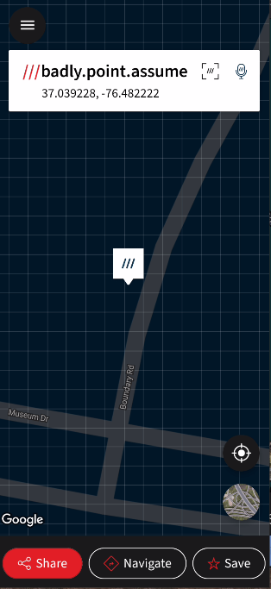
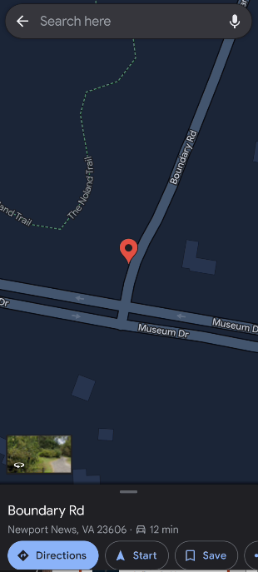
Step 7 – Another Example
Enter “///badly.point.assume”
Select “Navigate”
Select “Maps”
Select “Boundary Rd”, then the 3 dots, then download the offline map if needed
Select “Directions” to start the Google Maps mapping

Slide 13
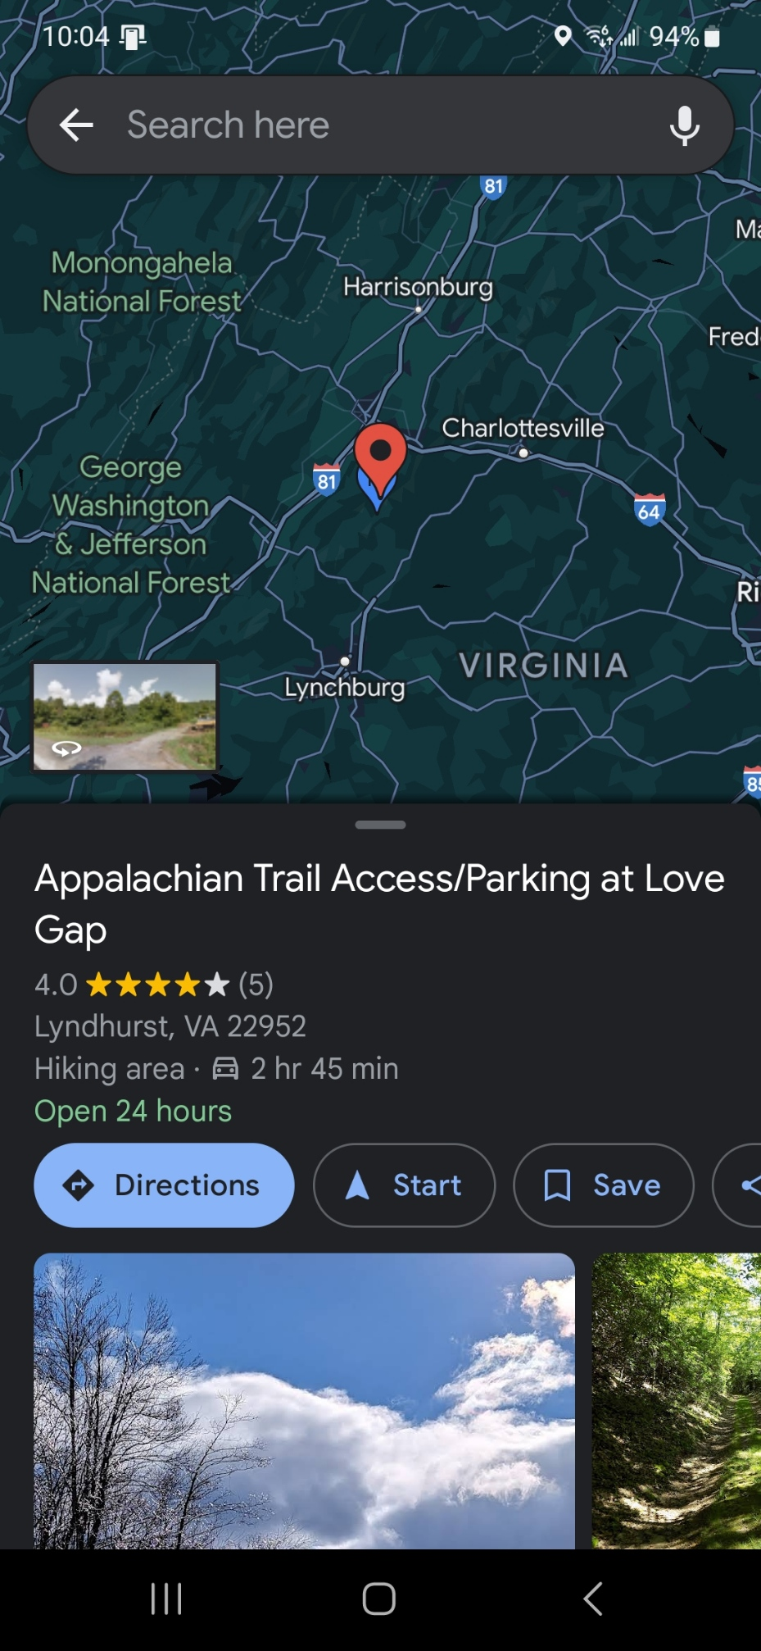
Step 8 – Yet Another Example
Enter “///safari.operated.recoil”
Select “Navigate”
Select “Maps”
Select “Appalachian Trail Access...”, then the 3 dots, then download the offline map if needed
Select “Directions” to start the Google Maps mapping

Slide 14
Questions or Comments?

Slide 15
Starter set of locations
Harper’s Creek Shelter – ///conquests.octane.credit
Three Ridges Summit – ///under.obliging.notable
Maupin Field Shelter – ///tattoo.returns.harmony
Reids Gap Trailhead – ///stimulating.journals.movements
Tye River Trailhead – ///window.vending.obstruct
Love Gap Fire Road Gate – ///safari.operated.recoil
Cow Pasture – ///timely.plays.reduces
Sherando Entrance – ///pull.trademark.unreliable
Williams Branch Picnic Entrance – ///observation.scramble.decisions
CCC Kitchen - ///hoped.flood.harvesting
Many of these locations were provided by/stolen from Jim Newman, thanks Jim!!!

Slide 16
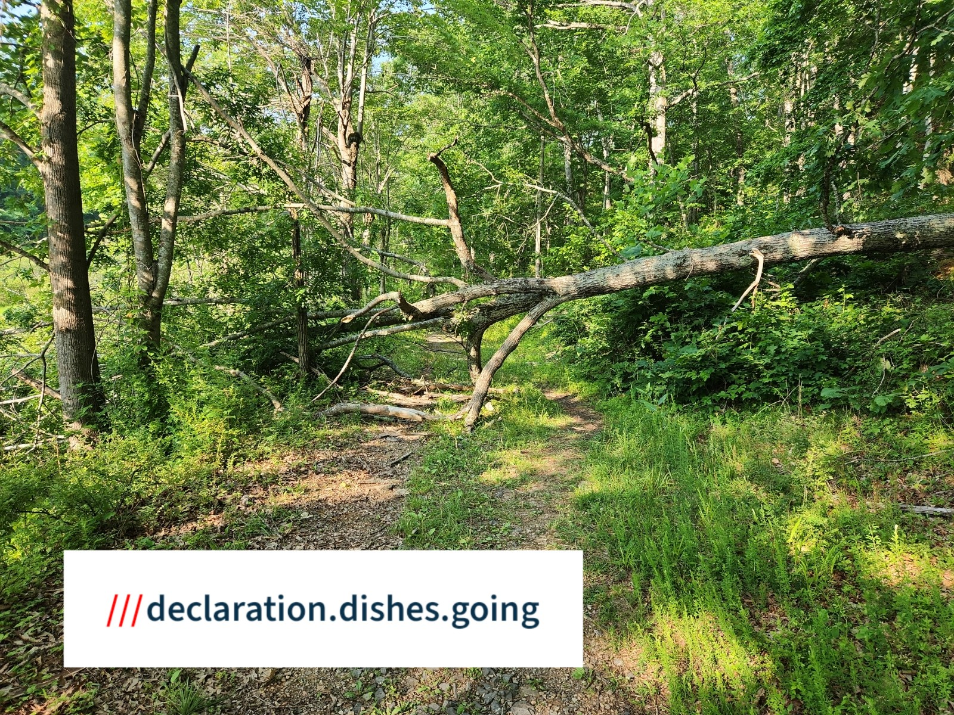
Walk-through Documentation with camera feature example
Open what 3 words
Select the gps button near the bottom right corner of the screen (cross-hairs with dot in the center) to center on current location
Select the 3 lines in the top left corner
Select “Photo mode”
Take a picture of the area/item requiring work
Select continue
Share ( ) via EMAIL, add email address, any desired text, then hit send. If you don’t have internet at the moment, the email will stay in the “outgoing” queue until you do. This does not always work with texting.
The pictures will also be in a folder on your phone if you need them later.

